Slide 1

Mobile Application Development
Dr. PRABHA SELVARAJ
Assistant Professor of CSE
Email:prabha.s@vitap.ac.in
Office: Faculty Area-9, Room 326F
third Floor, AB1
Notes:
01/06/12
1

Slide 2
Course Information (Cont’d)
Text Book:
Paul Deitel,Harvey Deitel,Android for programmers an app-driven approach Deiteldeveloper series, Abbey Deitel,Michael Morgano-2012 Pearson Education, Inc.
Reference Books:
App Programming Guide for iOS-Apple developer - 2014 Apple Inc
Jonathan Stark, Building iPhone Apps with HTML, CSS and JavaScript, O’Reilly Media, 2011.
Laird Dornin, G. Blake Meike, and Masumi Nakamura, Programming Android by Zigurd Mednieks, O’Reilly Media, 2011.
2
Notes:
01/06/12
2
01/06/12
2

Slide 3
Course Objectives
To understand mobile design principles.
To introduce implementation of the Application development with Android and IOS.
To develop competency in the Students to independently Design and Develop own professional apps.
3
Notes:
01/06/12
3
01/06/12
3

Slide 4
Expected Outcome
On completion of the course, students will have the ability to
Usage of development tools for the Android/IOS app development.
Usage of the major components of Android/IOS API set to develop their own apps
Use the Java programming language to build apps
Be familiar with new UI components and widgets
Store and manipulate data with apps
Do background processing with Services and Asynchronous Tasks
Package and prepare their apps for distribution on the Play Store

Slide 5
Course Description
Introduction to Mobile App development
Technologies- HTMl, javascript, jQuery for mobile APP development, Tools for APP development
User interface Design-components, Activities, Intents, Adapters, Notifications, Broadcast Receivers
Design and Testing-Drawables, Themes and Styles, Material design, Providing resources for adaptive layouts, Testing the user interface
Introduction to iOS
Data Storage and Access

Slide 6
The Mobile Ecosystem
Brief History of Mobile
The Mobile Ecosystem
Mobile as the 7th mass media

Slide 7
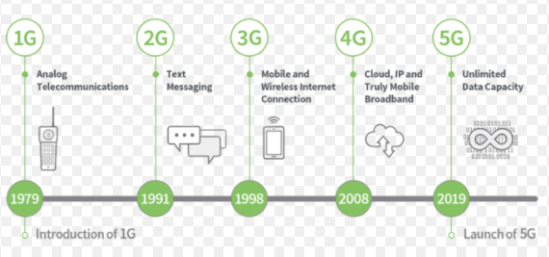
Evolution

Slide 8
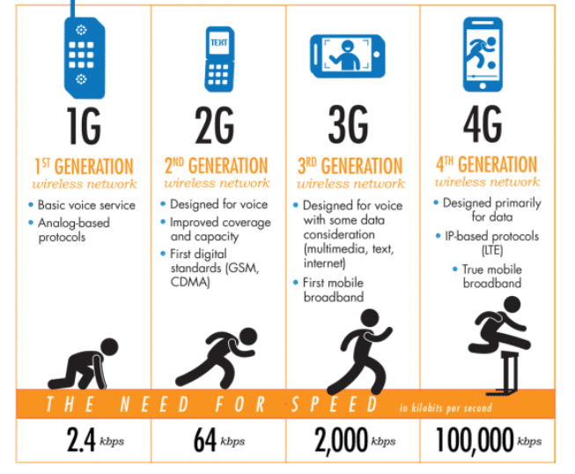
Brief history of Mobile
Many generation of mobiles
G is often referred to the networking aspect
– es. 2G, 3G, 4G

Slide 9
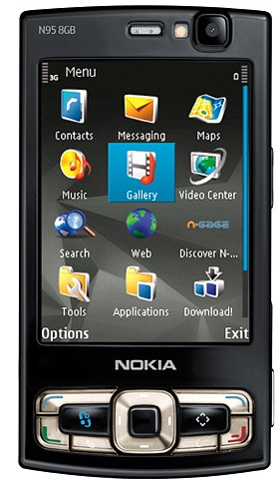
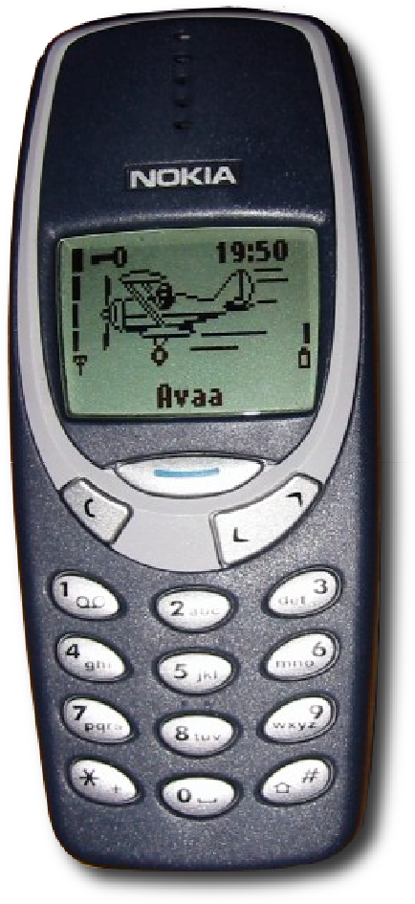
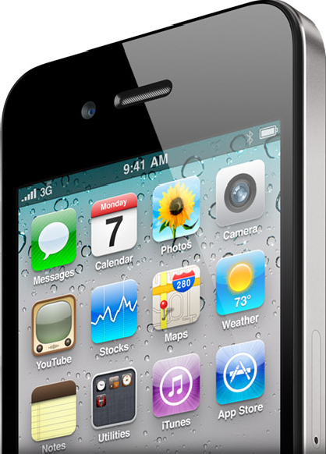
Brief history of Mobile
Motivation:
At some point a device comes and changes everything

Slide 10
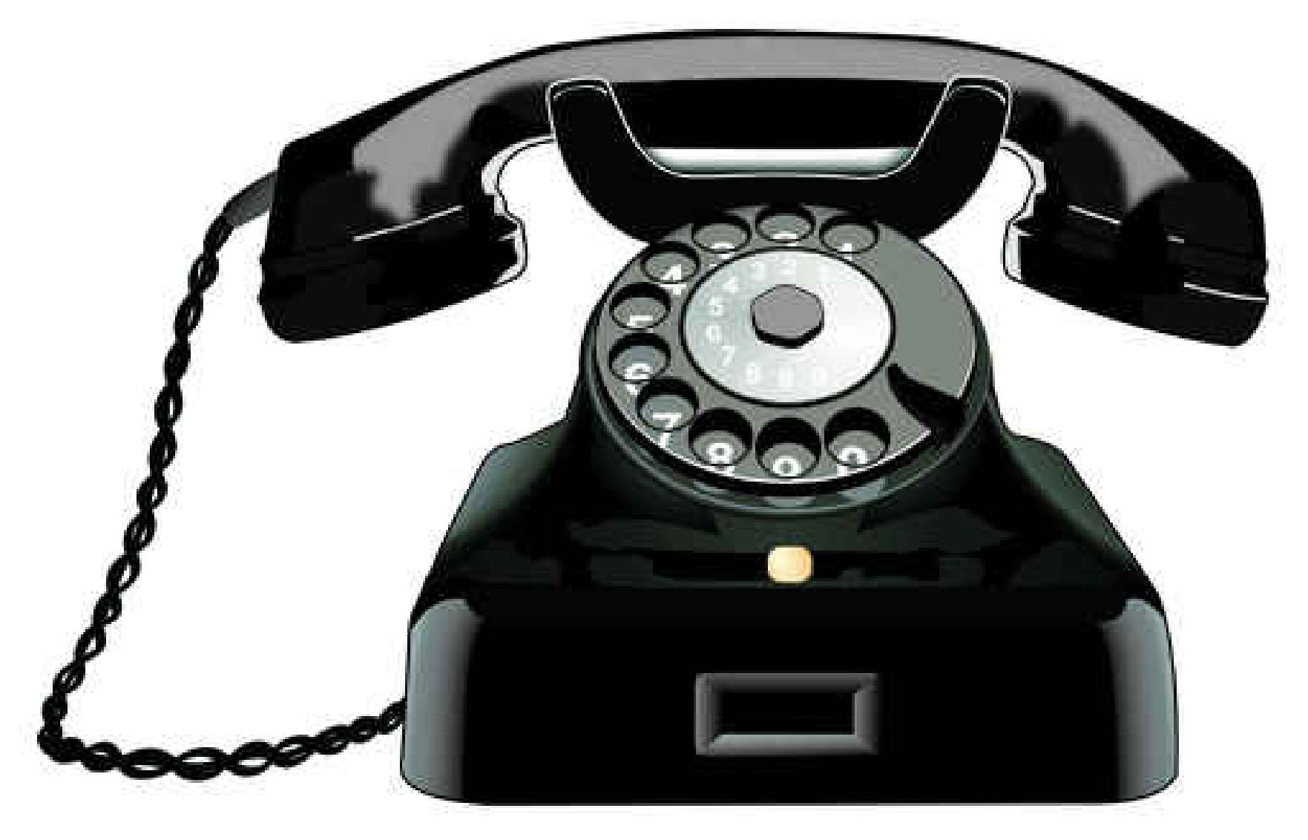
The beginning…

Slide 11
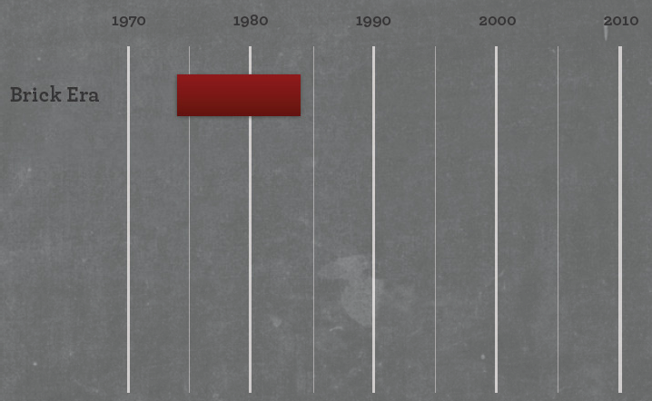
The Brick Era
* Picture lovely taken from http://www.slideshare.net/fling

Slide 12
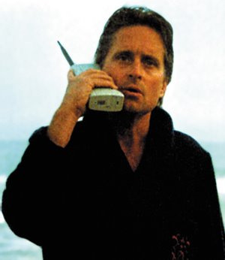
The Brick Era
calls
It was Portable!
More expensive than payphones
Enormous battery
Stakeholders:
– Stockbrokers, salespeople, …
After a while, more cellular radio towers and… it got (a little bit) smaller

Slide 13
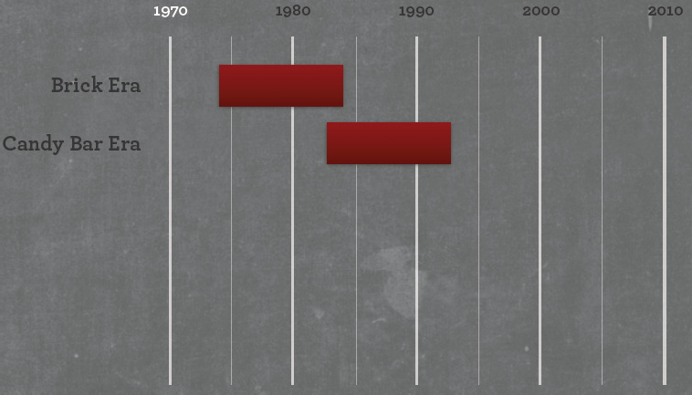
The Candy bar Era
* Picture lovely taken from http://www.slideshare.net/fling

Slide 14
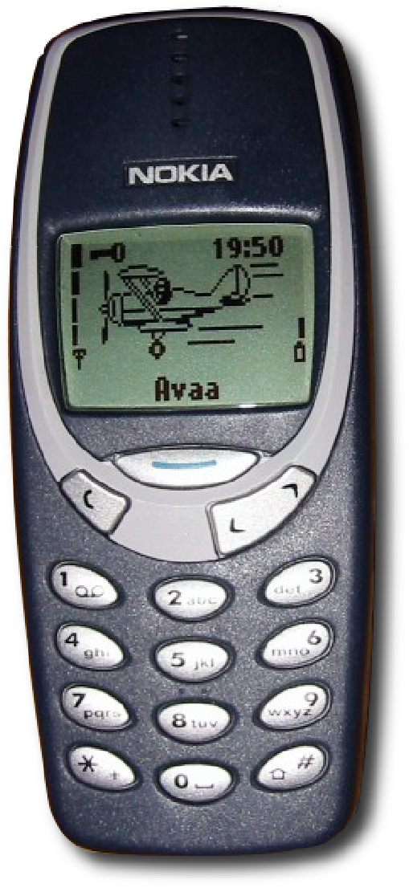
The Candy Bar Era
calls SMS
2G network : GSM, CDMA, TDMA, iDEN
More cellular towers
less power needed
much smaller
Better voice quality
Added SMS
Everyone wanted to have a mobile phone
– economic prosperity in EU, USA, and JP

Slide 15
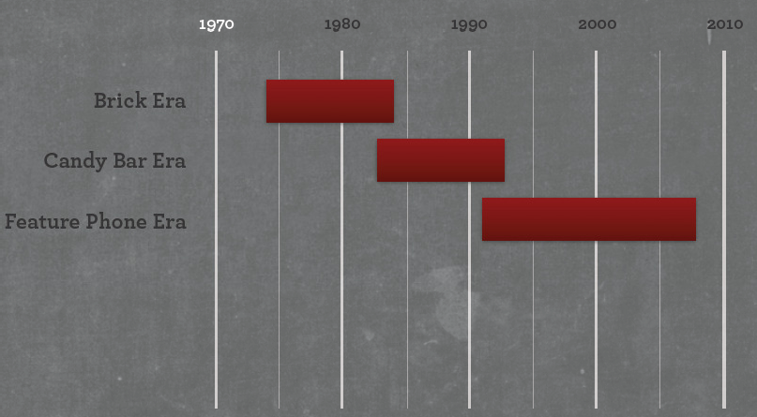
The Feature Phone Era
* Picture lovely taken from http://www.slideshare.net/fling

Slide 16
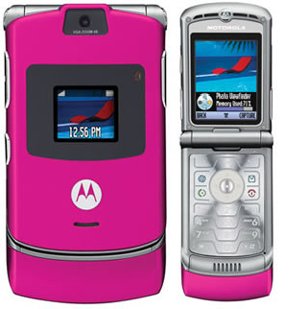
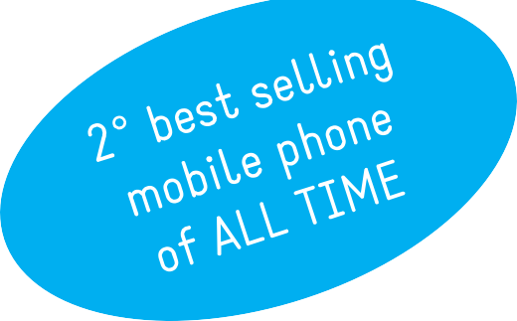
The Feature Phone Era
calls SMS & MMS music & photos
2.5G network: GPRS(General Packet Radio Service )
Camera
MMS
Data-capable devices
Internet on mobile (very poor)
high prices
poor marketing
inconsistent rendering

Slide 17
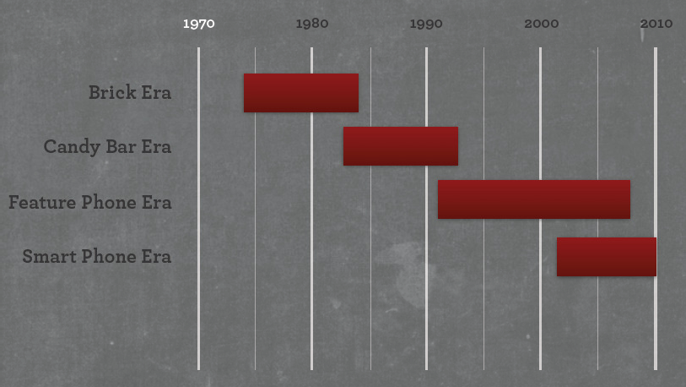
The Smartphone Era
* Picture lovely taken from http://www.slideshare.net/fling

Slide 18
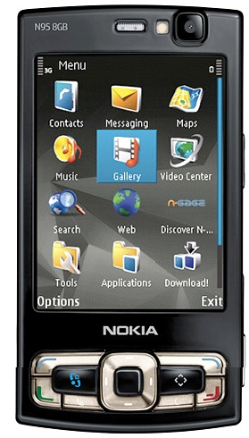
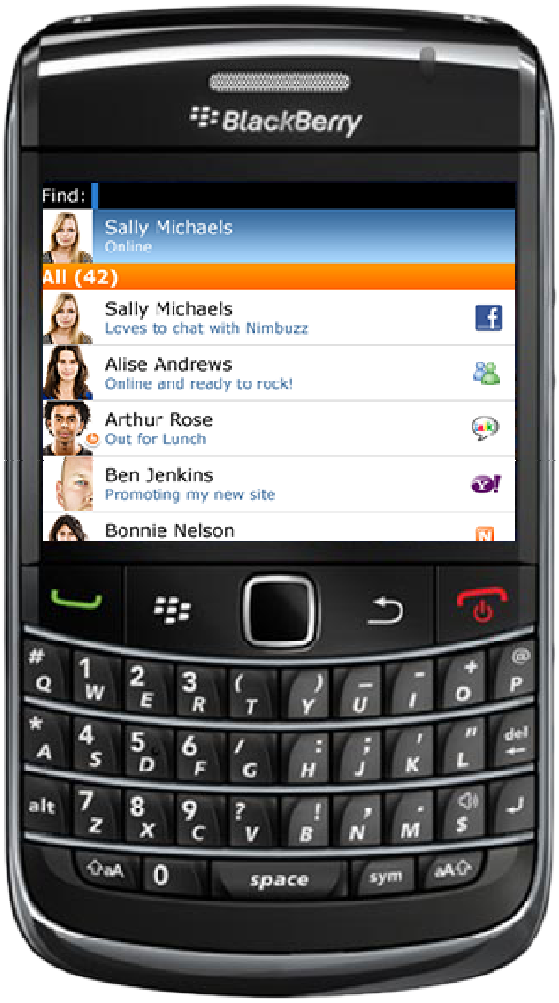
The Smartphone Era
calls SMS,MMS music & photos
3G, HSDPA(High-Speed Downlink Packet Access), WI-FI
Like a feature phone, but simulating a PC
Its own OS (es. Symbian)
Larger screens, stylus
The Mobile Platform becomes key
(push) email as primary driver

Slide 19
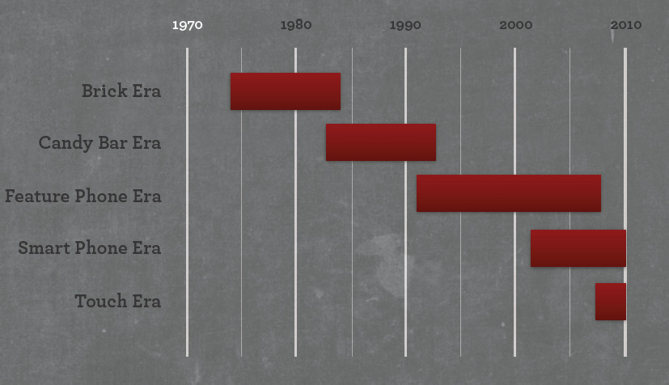
The Touch Era
* Picture lovely taken from http://www.slideshare.net/fling

Slide 20
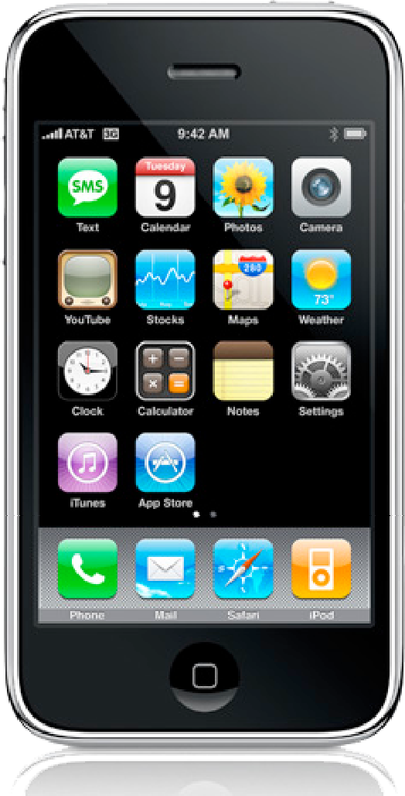
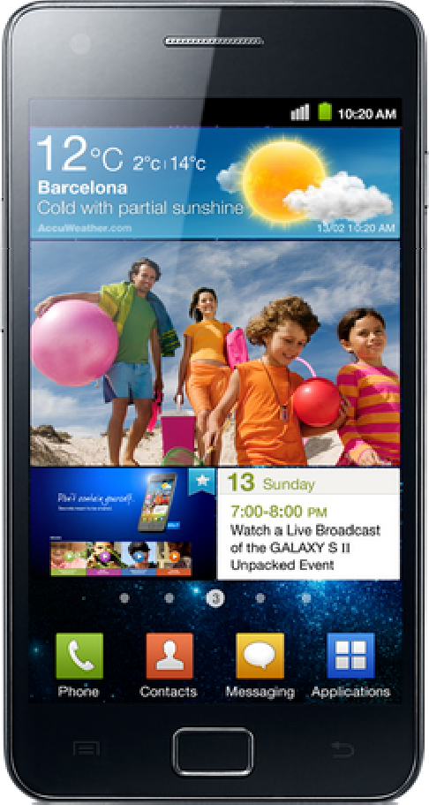
The Touch Era
calls SMS , MMS music & photos
3G, 4G
Accelerometers
GPS/Location-based
User-centered design
APPS
NOT a phone
-
NOT a computer
– true impact on his/her eveyday life
Rich interfaces
A personal media platform
Mobile web - everyday

Slide 21
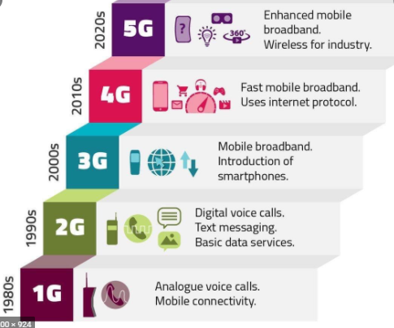

Slide 22
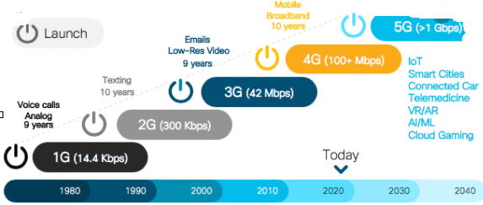

Slide 23
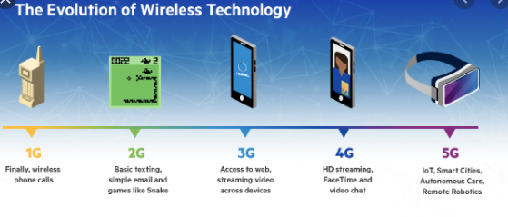

Slide 24
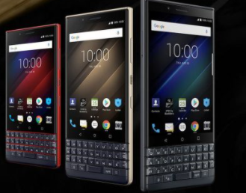
IoT era
5G
Age of boundless connectivity
intelligent automation
faster data rates
higher connection density
much lower latency
among other improvements
More than just faster internet
usher in new immersive experiences such as Virtual Reality and Augmented Reality

Slide 25
summary
Introduction to course.
Breif history
Generations
Brick, candy, feature phone, smart and touch era

Slide 26
Next class
Mobile Ecosystem
Mobile as MassMedia
Use of mobiles
Need of APP designing
Tips for APP designing.

